Slide 1
AC Network Analysis
Two distinct mechanisms for energy storage exist in electric circuits: capacitance and inductance, both of which lead to the storage of energy in an electromagnetic field.
The ideal capacitor and the ideal inductor.

Slide 2
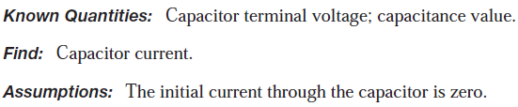
Ideal Capacitor
EXAMPLE 4.2 Calculating Capacitor Current from Voltage (Page 134)
Calculate the current through a capacitor from knowledge of its terminal voltage.
Assumptions: The capacitor is initially discharged: v(t = 0) = 0.

Slide 3
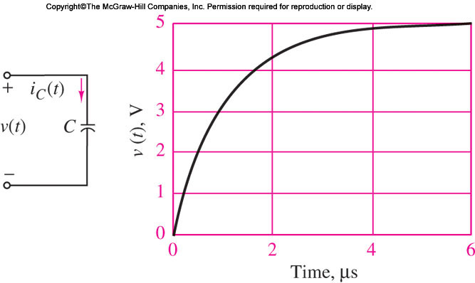
Ideal Capacitor
EXAMPLE 4.2 Calculating Capacitor Current from Voltage (Page 134)
Calculate the current through a capacitor from knowledge of its terminal voltage.

Slide 4
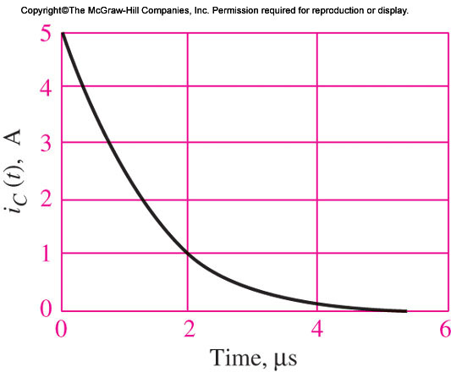
Ideal Capacitor
EXAMPLE 4.2 Calculating Capacitor Current from Voltage (Page 134)
Calculate the current through a capacitor from knowledge of its terminal voltage.

Slide 5
Ideal Capacitor
EXAMPLE 4.2 Calculating Capacitor Current from Voltage (Page 134)
Calculate the current through a capacitor from knowledge of its terminal voltage.
There are many useful applications of this energy storage property of capacitors in practical circuits.

Slide 6
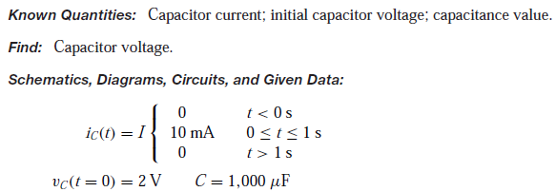
Ideal Capacitor
EXAMPLE 4.3 Calculating Capacitor Voltage from Current and Initial Conditions (Page 135)
There are many useful applications of this energy storage property of capacitors in practical circuits.
Problem
Calculate the voltage across a capacitor from knowledge of its current and initial state of charge.

Slide 7
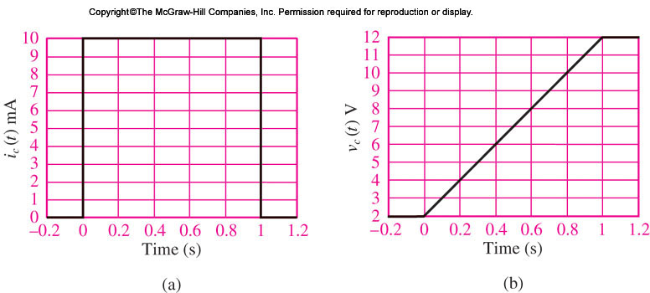
Ideal Capacitor
EXAMPLE 4.3 Calculating Capacitor Voltage from Current and Initial Conditions (Page 135)
There are many useful applications of this energy storage property of capacitors in practical circuits.

Slide 8
Energy Storage in Capacitors
Capacitor was described as ____________________ element
An expression for the energy stored in the capacitor WC(t) may be derived…
The instantaneous power in a circuit element is equal to the product of voltage and current……

Slide 9
Energy Storage in Capacitors
Capacitor was described as an energy storage element.
An expression for the energy stored in the capacitor WC(t) may be derived…
The instantaneous power in a circuit element is equal to the product of voltage and current……

Slide 10
Energy Storage in Capacitors
Energy Storage in Capacitors equation….
Whiteboard…

Slide 11
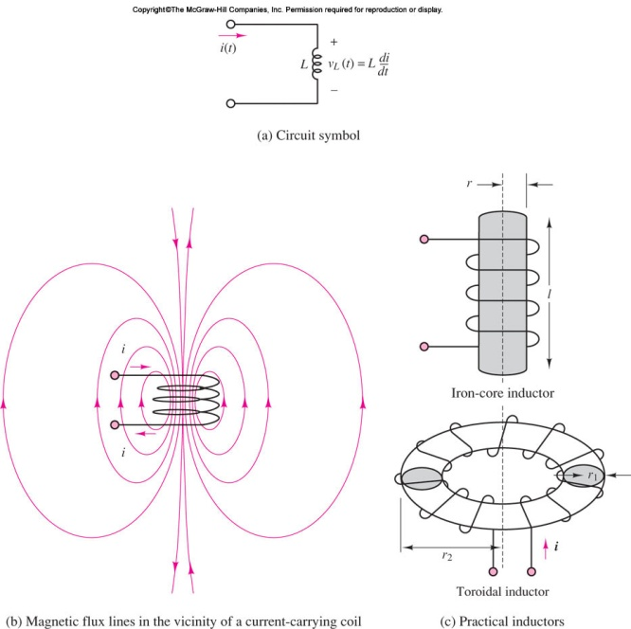
The Ideal Inductor
The ideal inductor is an element that has the ability to store energy in a magnetic field.
Inductors are typically made by winding a coil of wire around a core, which can be an insulator or a ferromagnetic material

Slide 12

The Ideal Inductor
Inductors are typically made by winding a coil of wire around a core, which can be an insulator or a ferromagnetic material

Slide 13



The Ideal Inductor
The ideal inductor acts as a short circuit in the presence of DC.
If a time-varying voltage is established across the inductor, a corresponding current will result, according to the following relationship:
Henrys are reasonable units for practical inductors; millihenrys (mH) and microhenrys (μH) are also used.

Slide 14
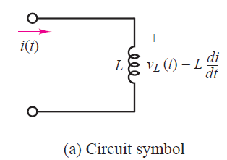
The Ideal Inductor

Slide 15
The Ideal Inductor
This duality between inductors and capacitors can be exploited to derive the same basic results for the inductor that we already have for the capacitor, simply by replacing the capacitance parameter C with the inductance L and voltage with current (and vice versa) in the equations we derived for the capacitor.
On the Whiteboard

Slide 16
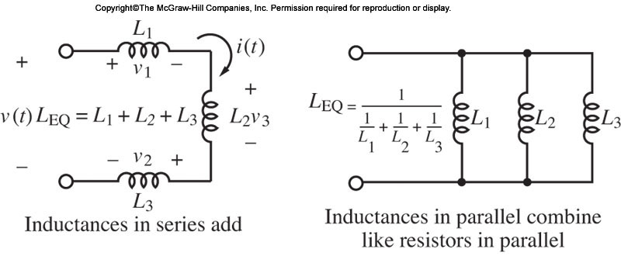
The Ideal Inductor
Inductors in parallel and series…

Slide 17
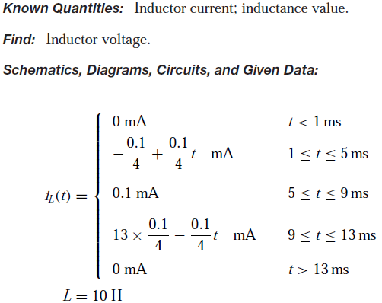
The Ideal Inductor - Examples
EXAMPLE 4.5 Calculating Inductor Voltage from Current
Problem
Calculate the voltage across the inductor from knowledge of its current.
Assumptions: iL(t = 0) ≤ 0.

Slide 18
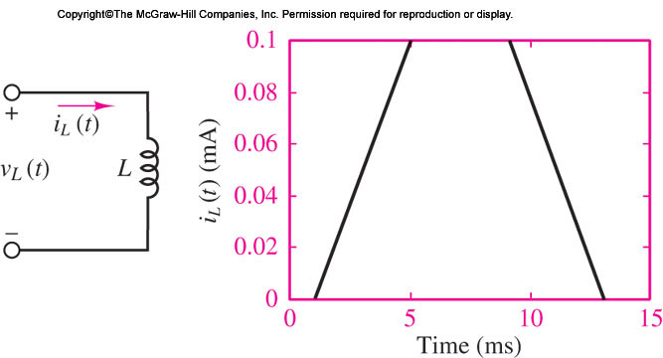
The Ideal Inductor - Examples
EXAMPLE 4.5 Calculating Inductor Voltage from Current
Problem
Calculate the voltage across the inductor from knowledge of its current.
Assumptions: iL(t = 0) ≤ 0.

Slide 19
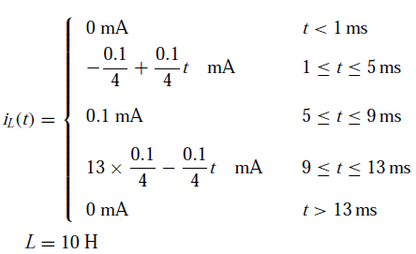
The Ideal Inductor - Examples
EXAMPLE 4.5 Calculating Inductor Voltage from Current

Slide 20
The Ideal Inductor - Examples
EXAMPLE 4.5 Calculating Inductor Voltage from Current
- On the Whiteboard

Slide 21
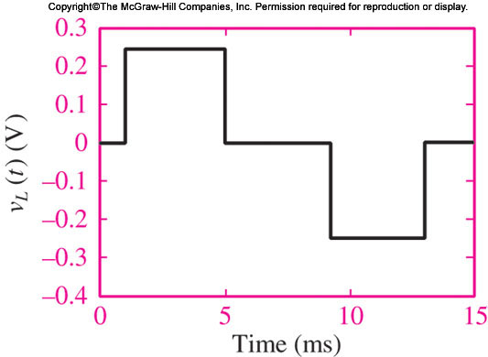
The Ideal Inductor - Examples
EXAMPLE 4.5 Calculating Inductor Voltage from Current
- On the Whiteboard

Slide 22
The Ideal Inductor - Examples
EXAMPLE 4.5 Calculating Inductor Voltage from Current
- On the Whiteboard

Slide 23
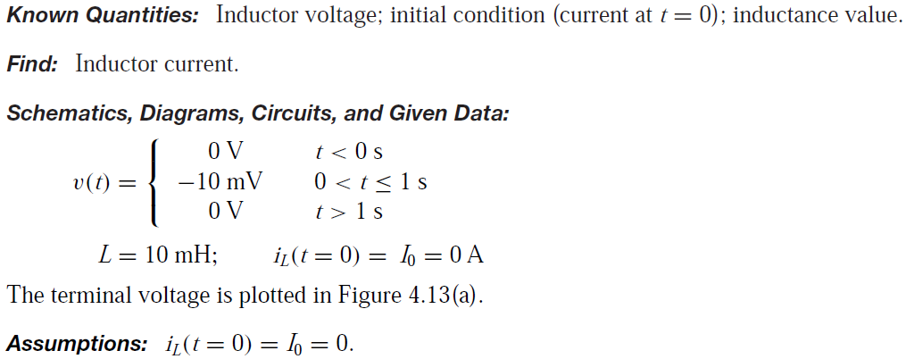
The Ideal Inductor - Examples
EXAMPLE 4.6 Calculating Inductor Current from Voltage
Problem
Calculate the current through the inductor from knowledge of the terminal voltage and of the
initial current. (Page 142)

Slide 24
The Ideal Inductor - Examples
EXAMPLE 4.6 Calculating Inductor Current from Voltage
Problem
Calculate the current through the inductor from knowledge of the terminal voltage and of the
initial current. (Page 142)
On the whiteboard

Slide 25
Energy Storage in Inductors
The magnetic energy stored in an ideal inductor maybe found from a power calculation by following the same procedure employed for the ideal capacitor. The instantaneous power in the inductor is given by
On the whiteboard

Slide 26

Energy Storage in Inductors - Examples
EXAMPLE 4.7 Energy Storage in an Ignition Coil
Problem
Determine the energy stored in an automotive ignition coil. (Page 144)

Slide 27
Energy Storage in Inductors - Examples
EXAMPLE 4.7 Energy Storage in an Ignition Coil
Problem
Determine the energy stored in an automotive ignition coil. (Page 144)
On the whiteboard

Slide 28
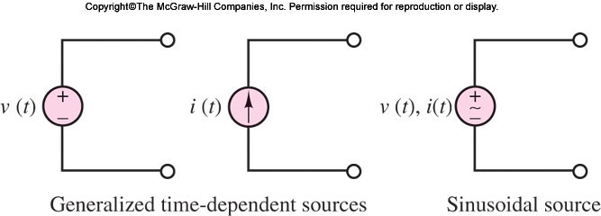
AC Network Analysis
Time-dependent signal sources

Slide 29
Time-dependent Signal Sources
Time-dependent signal sources: sources that generate time-varying voltages and currents and, in particular, sinusoidal sources.

Slide 30
Time-dependent Signal Sources
One of the most important classes of time-dependent signals is that of periodic signals.
These signals appear frequently in practical applications and are a useful approximation of many physical phenomena.

Slide 31
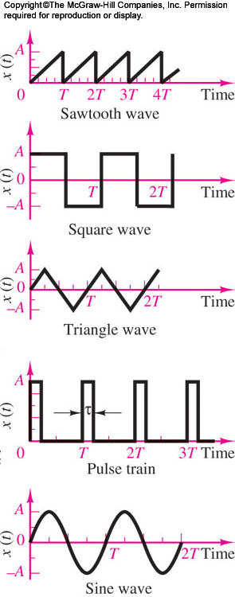
Time-dependent Sources
One of the most important classes of time-dependent signals is that of periodic signals.
These signals appear frequently in practical applications and are a useful approximation of many physical phenomena.

Slide 32

Time-dependent Signal Sources
A periodic signal x(t) is a signal that satisfies the equation.

Slide 33
Time-dependent Sources
Waveforms such as the sine, triangle, square, pulse, and sawtooth waves are provided in the form of voltages (or, less frequently, currents) by commercially available signal (or waveform) generators.

Slide 34
AC Network Analysis
Such instruments allow for selection of the waveform peak amplitude, and of its period.

Slide 35
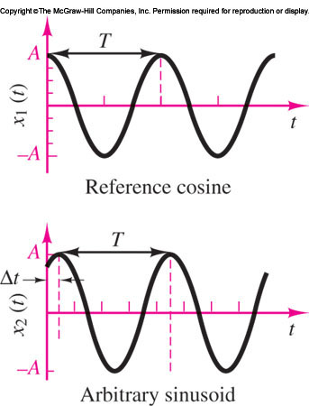

Time-dependent Signal Sources- Sinusoidal
Sinusoidal waveforms constitute by far the most important class of time-dependent signals. Figure depicts the relevant parameters of a sinusoidal waveform.
A generalized sinusoid is defined as

Slide 36



Time-dependent Signal Sources- Sinusoidal
A generalized sinusoid is
defined as

Slide 37
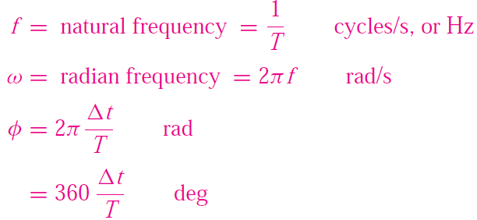
Time-dependent Signal Sources- Sinusoidal

Slide 38

Time-dependent Signal Sources- Sinusoidal
The phase shift φ permits the representation of an arbitrary sinusoidal signal.
one can represent a sine wave in terms of a cosine wave simply by introducing a phase shift of π/2 rad:

Slide 39
References
Giorgio Rizzoni, “Fundamentals of Electrical Engineering”, McGraw- Hill Education, 2009. ISBN. 978-0-07-338037-7
Peyton Z. Peebles (Author), Tayeb A. Giuma, Principles of Electrical Engineering (Mcgraw Hill Series in Electrical and Computer Engineering), Mcgraw-Hill College, 1991.
Allan R. Hambley, Electrical Engineering: Principles and Applications, Prentice Hall, ISBN-0132130068, 9780132130066, 2011.

Slide 40
Thank you !
Question?

